Slide 1
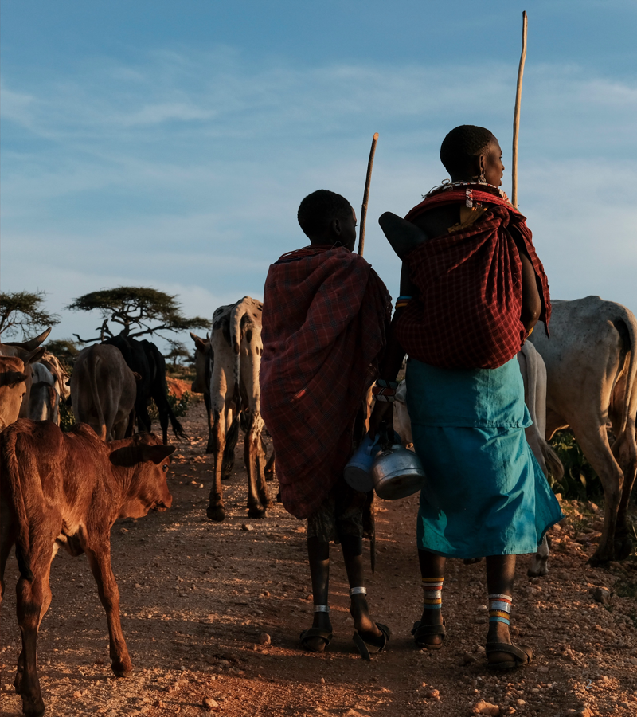

Will treatment work?
MODULES 4–5 · DAYS 4–5
Genotype versus phenotype, empiric therapy, and the plasmids that carry resistance
Neonatal AMR genomic surveillance of K. pneumoniae and E. coli
KlebGen training · Africa CDC and ILRI
Module 4 · Genotype, phenotype and plasmids | Day 4
Notes:
Day 4. Yesterday we listed the resistance genes in every isolate. Today we ask whether those genes predict what the lab measured, what that means for the WHO empiric regimens for neonatal sepsis, and, in the afternoon, where the genes live: on the chromosome or on plasmids that can move between lineages.

Slide 2

Days 4–5 at a glance
Day · session | Time | Topic | Module
Day 4 · 1 | 09:00–10:30 | Genotype versus phenotype: how far can we trust predictions? | 4
Day 4 · 2 | 11:00–12:30 | From genes to empiric therapy for neonatal sepsis | 4
Day 4 · 3 | 13:30–15:00 | Plasmids, replicons and mobility; MOB-suite | 5
Day 4 · 4 | 15:30–17:00 | Which plasmid carries which gene? Short-read versus hybrid | 5
Day 5 · 1 | 09:00–10:30 | Plasmid clusters: is the same plasmid in different lineages? | 5
Day 5 · 2 | 11:00–12:30 | Genetic context of a resistance gene (Bakta annotation) | 5
You will produce
a genotype–phenotype agreement table, a regimen summary, a plasmid table for the three hybrids, and a plasmid-sharing table
Module 4 · Genotype, phenotype and plasmids | Day 4
2
Notes:
Day 4: the interpretation half of Module 4 in the morning, then the first half of Module 5. Day 5 morning (shaded rows) finishes Module 5: plasmids shared between lineages, and the genes around a resistance gene. Day 5 afternoon is the course pipeline, which has its own slides.

Slide 3
By the end of these sessions you can
1
Predict susceptibility from AMR genes and measure agreement with lab AST (very major and major errors).
2
Explain disagreements between genotype and phenotype.
3
Estimate how often WHO-recommended empiric neonatal regimens would fail, and say why that estimate is limited.
4
Reconstruct plasmids with MOB-suite and say which plasmid carries each resistance gene.
5
Explain why short-read assemblies rarely give complete plasmids.
6
Group plasmids into clusters and find plasmids shared between lineages or species.
7
Annotate a plasmid and describe the genetic context of a resistance gene.
1–3: Module 4, Day 4 morning
4–5: Module 5, Day 4 afternoon
6–7: Module 5, Day 5 morning
Module 4 · Genotype, phenotype and plasmids | Day 4
3
Notes:
Objectives 1 to 3 are Module 4 (Day 4 morning); 4 and 5 are Module 5, part 1 (Day 4 afternoon); 6 and 7 are Module 5, part 2 (Day 5 morning).

Slide 4

Genotype versus phenotype
SESSION 1 · 09:00–10:30 · MODULE 4
How far can we trust resistance predicted from genes?
Module 4 · Genotype, phenotype and plasmids | Day 4
4
Notes:
Session 1. The lab tested these isolates by disc diffusion. We turn yesterday's gene lists into predicted S or R calls and count how often the two agree, and how they disagree.

Slide 5
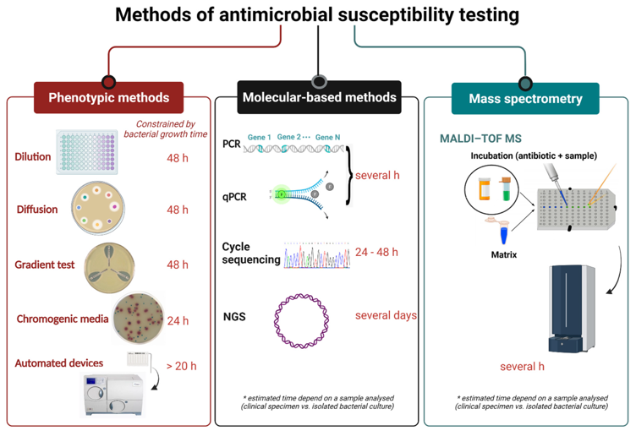
Detecting resistance in the lab: AST
Phenotypic AST
Grows the bacterium with the antibiotic and measures the response. MIC: the lowest concentration that inhibits growth.
Disc diffusion (this study)
Zone diameter around a disc, read as S, I or R against clinical breakpoints (EUCAST or CLSI).
Molecular AST
Detects resistance determinants. PCR targets a few genes in hours; WGS screens for all known ones, but only predicts the phenotype.
Gajic I, et al. Antibiotics 2022. doi:10.3390/antibiotics11040427
Module 4 · Genotype, phenotype and plasmids | Day 4
5
Notes:
AST is still the reference standard for treatment decisions: it measures what the bacterium does, not what genes it has. Our isolates were tested by disc diffusion, so we have S, I or R per drug rather than MICs. A genome finds every known determinant in one test, but it can only predict the phenotype from what is in the database. The MBC (the lowest concentration that kills 99.9% of bacteria) is rarely measured in routine labs and is not used today.

Slide 6
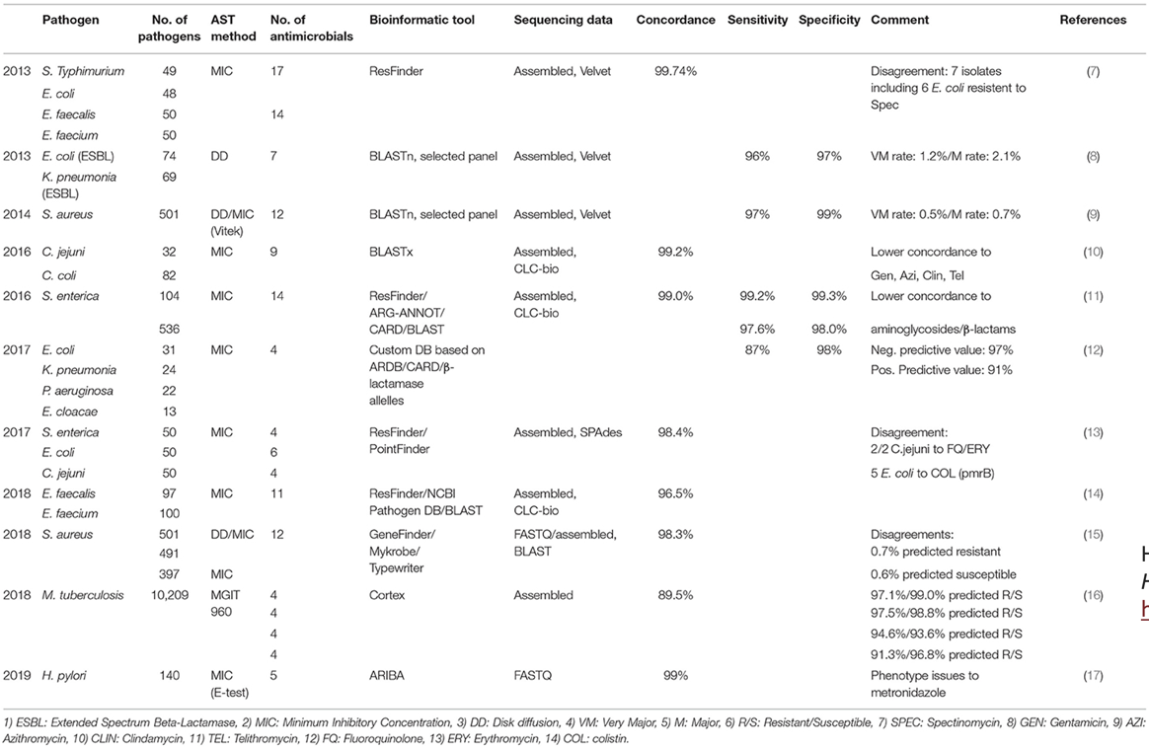
How well do genes predict AST?
>96%
concordance between acquired genes or mutations and MIC
>87% · >97%
sensitivity and specificity, depending on species
Agreement is lower for some drugs, including aminoglycosides and β-lactams: the drugs of the neonatal regimens.
Hendriksen RS, et al. Front Public Health 2019. doi:10.3389/fpubh.2019.00242
Module 4 · Genotype, phenotype and plasmids | Day 4
6
Notes:
Across many studies, WGS predicts the phenotype well, but not equally well for every drug. The 2013 E. coli and K. pneumoniae ESBL study reported a very major error rate of 1.2% and a major error rate of 2.1%; we define those terms in a few slides and then calculate them for our own isolates. Note that most of these studies used MICs; we have disc diffusion, which is noisier.

Slide 7
R, step 1: read the three tables
# shell: use_tools r; cd $COURSE; R
library(tidyverse)
meta <- read_tsv("training_data/metadata_compact.tsv")
ast <- read_tsv("training_data/ast_compact.tsv", na = "NA")
amr <- read_tsv("results/04_amr/amrfinderplus_all.tsv") |>
rename(sample = Name,
gene = any_of(c("Element symbol",
"Gene symbol"))) |>
select(sample, gene, Class, Subclass)
library(tidyverse) loads readr, dplyr, tidyr and stringr together.
meta: one row per isolate. ast: one column per disc, values S, I or R. amr: one row per gene found.
|> passes the result on to the next function.
any_of() renames whichever gene column exists: its name differs between AMRFinderPlus versions.
Subclass names the drugs a gene affects, e.g. GENTAMICIN.
Module 4 · Genotype, phenotype and plasmids | Day 4
7
Notes:
Copy the code from the Day 4 page, not from the slides: the slides wrap some lines to fit. na = "NA" makes the text NA a missing value, so isolates without a result for a drug are not counted as S or R. AMRFinderPlus version 4 calls the gene column "Element symbol"; version 3 called it "Gene symbol". any_of() lets the same script work with either.

Slide 8
R, step 2: the prediction rules
# An isolate is predicted R if any hit's Subclass matches the pattern
rules <- tribble(
~drug, ~ast_column, ~pattern,
"Gentamicin", "Gentamicin 10", "GENTAMICIN",
"Ceftriaxone", "Cefpodoxime 10 (Ceftriaxone)", "CEPHALOSPORIN|CARBAPENEM",
"Meropenem", "Meropenem 10", "CARBAPENEM",
"Amikacin", "Amikacin 30", "AMIKACIN",
"Ciprofloxacin", "Ciprofloxacin 5", "QUINOLONE"
)
tribble()
ast_column
pattern
A small table typed row by row: one rule per drug.
The matching disc in the AST table. Cefpodoxime stands in for ceftriaxone.
A regular expression: | means "or". Carbapenemases also break ceftriaxone.
Module 4 · Genotype, phenotype and plasmids | Day 4
8
Notes:
These rules are deliberately simple: any gene whose Subclass mentions the drug or its class predicts resistance. Real interpretation tools use expert rules, such as which beta-lactamases hydrolyse which drugs, and which aac(6') variants affect amikacin. Ask the group: what would this rule get wrong? We will see the answer in the disagreements.

Slide 9
R, step 3: predict R or S
pred <- rules |>
crossing(sample = meta$sample) |>
left_join(amr, by = "sample",
relationship = "many-to-many") |>
group_by(drug, ast_column, sample) |>
summarise(
hit = any(str_detect(Subclass, pattern),
na.rm = TRUE),
genes = paste(unique(gene[which(
str_detect(Subclass, pattern))]),
collapse = ";"),
.groups = "drop") |>
mutate(genotype = if_else(hit, "R", "S"))
crossing(): every drug with every isolate, 5 × 29 = 145 rows.
left_join(): adds each isolate's genes; one row per drug, isolate and gene.
summarise(): back to one row per drug and isolate. hit is TRUE if any gene matches.
genes keeps the genes behind each call, for explaining disagreements.
if_else(): hit → "R", no hit → "S".
Module 4 · Genotype, phenotype and plasmids | Day 4
9
Notes:
Walk through it one line at a time; print the intermediate table after each step if the group is new to R. relationship = "many-to-many" tells dplyr we expect many rules and many genes per isolate, which silences a warning. An isolate with no AMRFinderPlus hits gets an NA Subclass; na.rm = TRUE makes that FALSE, so it is predicted S. The genes column is empty for S calls.

Slide 10
R, step 4: compare with AST
ast_long <- ast |>
pivot_longer(-sample, names_to = "ast_column", values_to = "phenotype") |>
filter(phenotype %in% c("S", "R")) # intermediate (I) results left out
cmp <- pred |>
inner_join(ast_long, by = c("sample", "ast_column")) |>
mutate(result = case_when(
genotype == phenotype ~ "agree",
genotype == "S" & phenotype == "R" ~ "very major error (missed resistance)",
genotype == "R" & phenotype == "S" ~ "major error (false resistance)"
))
write_tsv(cmp, "results/04_amr/genotype_vs_phenotype.tsv")
pivot_longer(): one row per isolate and disc, like pred
inner_join(): keeps only pairs with both a prediction and an AST result
case_when(): labels each pair, first matching rule wins
Module 4 · Genotype, phenotype and plasmids | Day 4
10
Notes:
The AST table is wide: one column per disc. pivot_longer turns it long so it has the same shape as pred, and the two can be joined on sample and ast_column. Intermediate results are dropped because a genotype only predicts S or R; mention that this choice changes the denominators. Missing AST (NA) also drops out here, which matters for the two NDM-1 isolates.

Slide 11
Very major and major errors
AST: R
AST: S
Very major error: a patient could get a drug that does not work. This is the dangerous one.
Agree
Major error
false resistance
Genome: R
Major error: a drug that would work might be withheld.
Very major error
missed resistance
Agree
Genome: S
# One row per drug, one column per result
cmp |> count(drug, result) |>
pivot_wider(names_from = result, values_from = n, values_fill = 0)
Module 4 · Genotype, phenotype and plasmids | Day 4
11
Notes:
The terms come from the evaluation of AST devices: the reference is the lab phenotype and the genome is the test. count() tallies results per drug; pivot_wider turns the tally into one row per drug, and values_fill = 0 writes 0 where a drug has no errors of a type. This is the agreement table you hand in today. Ask: for which drug do you expect most errors, and of which type?

Slide 12
Exercise: explain the disagreements
cmp |> filter(result != "agree") |> select(sample, drug, genes, genotype, phenotype)
Pick two disagreements. Which of these explains each?
Low-level resistance
Porins or efflux
Truncated gene
The gene raises the MIC, but not above the breakpoint.
Resistance without an acquired gene; gene screening misses it.
A partial or broken copy is detected but not expressed.
AST error
Database or version
Our rule
Wrong breakpoints, wrong disc, or a mixed culture.
A newer database, or another tool, calls it differently.
A simple text match on Subclass is not an expert rule.
Module 4 · Genotype, phenotype and plasmids | Day 4
12
Notes:
Give pairs 15 minutes. The genes column from step 3 is the starting point: for a major error, which gene drove the R call, and is it known to cross the breakpoint? For a very major error, there is no gene, so think about chromosomal mechanisms (porin loss in ompK35 and ompK36, efflux) and about the lab. The last card is ours: the rules we wrote are crude on purpose.

Slide 13
Two cases to look at
AMIKACIN
aac(6')-Ib and its -cr variant, common in CTX-M-15 lineages, modify amikacin, but often not enough to cross the breakpoint. Expect major errors.
THE TWO NDM-1 ISOLATES
BHB7VE has no meropenem result; CES1C7 has no AST at all.
High-level amikacin resistance usually comes from 16S rRNA methylases (armA, rmtB).
The genome is the only evidence of carbapenem resistance. A carbapenemase gene in a neonatal isolate should trigger phenotypic confirmation and an infection-control alert, whatever the AST shows.
BHB7VE (ST39, NDM-1) is amikacin-resistant by AST. Which genes could explain it?
Module 4 · Genotype, phenotype and plasmids | Day 4
13
Notes:
BHB7VE: in the published results it carries aph(3')-VI and aac(6')-Ib'; ask trainees to check what their own AMRFinderPlus run found before revealing that. The NDM-1 point is about surveillance practice: missing AST is common, and the genome then carries the evidence. Because inner_join drops missing AST, these isolates do not appear in the agreement table at all for meropenem.

Slide 14

From genes to empiric therapy
SESSION 2 · 11:00–12:30 · MODULE 4
How often would the WHO regimens for neonatal sepsis fail?
Module 4 · Genotype, phenotype and plasmids | Day 4
14
Notes:
Session 2. Empiric therapy is given before any culture result exists, so it depends on knowing which resistance is common locally. We reuse the predictions from Session 1 to ask which regimen would fail for each isolate, and then ask what that number can and cannot tell us.

Slide 15

Which prediction decides each regimen?
Regimen | Used as | Fails if predicted R to
Ampicillin + gentamicin | WHO first line | Gentamicin (ampicillin is intrinsic R in KpSC)
Third-generation cephalosporin | WHO second line | Ceftriaxone (ESBL or carbapenemase)
Meropenem | Reserve | Meropenem (carbapenemase)
Amikacin | Alternative aminoglycoside | Amikacin
Against K. pneumoniae, first-line treatment rests on gentamicin alone: an acquired aac(3) gene removes it.
Module 4 · Genotype, phenotype and plasmids | Day 4
15
Notes:
A recap of Day 3: SHV in K. pneumoniae and LEN in K. variicola make ampicillin useless, so the first-line regimen relies on gentamicin. Check the WHO guidance current in your country; these labels follow the WHO recommendations for neonatal sepsis used in the course. Ciprofloxacin is in the prediction rules but not in a neonatal regimen, so it drops out here.

Slide 16
R: predicted regimen failure
regimen <- pred |>
select(sample, drug, genotype) |>
pivot_wider(names_from = drug, values_from = genotype) |>
transmute(
sample,
`Ampicillin + gentamicin` = Gentamicin,
`Third-generation cephalosporin` = Ceftriaxone,
Meropenem,
Amikacin
)
regimen |>
pivot_longer(-sample, names_to = "regimen",
values_to = "predicted") |>
group_by(regimen) |>
summarise(n = n(),
predicted_failure = sum(predicted == "R"),
percent = round(100 * predicted_failure / n))
pivot_wider(): one row per isolate, one column per drug.
transmute(): renames drugs to regimens and keeps only those columns. Back-ticks allow spaces in names.
pivot_longer() then summarise(): per regimen, the number of isolates, how many are predicted R, and the percentage.
Uses predictions for all 29 isolates, not only those with AST.
Module 4 · Genotype, phenotype and plasmids | Day 4
16
Notes:
The comment in the course code reminds you that ampicillin is intrinsically resistant in KpSC, which is why the first-line column is simply the gentamicin prediction. Ask the room to predict the ranking of the four regimens before running it. Then compare with the AST: would the percentages from the lab results be similar?

Slide 17
Why this is not a failure rate
You cannot report: "the regimen fails in X% of neonatal infections in Malawi".
1
2
3
The 29 isolates were chosen, not sampled at random: two clusters and two carbapenemase isolates are over-represented.
Only 15 of the 29 are from neonates.
All isolates come from one hospital.
A defensible estimate needs all (or a random sample of) neonatal bloodstream isolates from defined facilities and periods, with the denominator stated.
Module 4 · Genotype, phenotype and plasmids | Day 4
17
Notes:
Ask the group first: why can't you report these percentages as a failure rate? Collect answers, then reveal the three reasons. Then the regimen summary trainees write today should include one sentence saying why the percentages are not prevalence. This is the same point as ST39 on Day 3: a training set is built to teach, not to estimate.

Slide 18

Plasmids, replicons and mobility
SESSION 3 · 13:30–15:00 · MODULE 5
Reconstructing plasmids from assemblies with MOB-suite
Module 4 · Genotype, phenotype and plasmids | Day 4
18
Notes:
Session 3 starts Module 5. So far we have asked which genes an isolate carries. Now we ask where they are: on the chromosome, inherited with the lineage, or on a plasmid that can move to other lineages and species.

Slide 19
Plasmids: the words we need
A plasmid is a circle of DNA that replicates apart from the chromosome. Plasmids can move resistance genes between lineages and species.
Replicon (Inc) type
Conjugative
The plasmid's replication machinery, used to classify it: IncFII, IncFIB(K), IncX3, IncL…
Carries everything needed to transfer itself to another bacterium.
Mobilisable
Insertion sequence, transposon
Can transfer only with help from a conjugative plasmid in the same cell.
Smaller mobile elements that move genes within and between plasmids: IS26, ISEcp1, Tn4401.
Module 4 · Genotype, phenotype and plasmids | Day 4
19
Notes:
Mobility works at three levels: plasmids move between cells; transposons and insertion sequences move genes between plasmids and the chromosome. Two plasmids with the same replicon cannot usually be kept stably in one cell (incompatibility, the origin of the Inc name). A cell can carry several plasmids with different replicons, and one plasmid can carry more than one replicon, as we will see.

Slide 20
Common resistance plasmids
IncFII / IncFIB(K)
IncL
IncX3
with blaCTX-M-15
with blaOXA-48
with blaNDM-5
ESBL: third-generation cephalosporin resistance
Carbapenemase
Carbapenemase
In our hybrid isolates: a ~143 kb IncFII(K) + IncR plasmid in both CHI11E (ST39) and CNS1F1 (ST45). Same plasmid, two lineages?
Module 4 · Genotype, phenotype and plasmids | Day 4
20
Notes:
These pairings are typical in Enterobacterales, not fixed rules: the same gene can sit on different plasmids, and the same plasmid backbone can carry different genes. The question at the bottom is the thread through this afternoon and tomorrow, when we compare plasmids with Mash.

Slide 21
Finding plasmids in a genome
PlasmidFinder
MOB-suite (today)
Searches contigs for known replicon sequences with BLASTn.
Sorts contigs into chromosome and plasmids, then types each plasmid.
Answers: which Inc types are present?
Not: which contigs belong to which plasmid.
Answers: how many plasmids, how big, which replicons, can they move?
cge.food.dtu.dk/services/PlasmidFinder
github.com/phac-nml/mob-suite
Module 4 · Genotype, phenotype and plasmids | Day 4
21
Notes:
PlasmidFinder is the quick web tool many labs already use; it is a good first look and its replicon names match what MOB-suite reports. Virulence gene screening (VirulenceFinder, VFDB) was covered on Day 3 through Kleborate, so it is not repeated here. MOB-suite goes further by grouping contigs into plasmids, which is what lets us link a resistance gene to a particular plasmid.

Slide 22

How MOB-suite works
1 · MOB_RECON
2 · GROUP
3 · MOB_TYPER
Compares each contig with a database of complete plasmids and finds replicon and relaxase markers.
Groups plasmid contigs into clusters: one cluster = one predicted plasmid. The rest is chromosome.
Types each plasmid: size, replicons, and predicted mobility.
Output file | Contents
chromosome.fasta | Contigs assigned to the chromosome
plasmid_<cluster>.fasta | Contigs of one predicted plasmid
mobtyper_results.txt | size, rep_type(s), predicted_mobility, primary_cluster_id
contig_report.txt | Which contig went where, and why
Module 4 · Genotype, phenotype and plasmids | Day 4
22
Notes:
Predicted mobility is conjugative, mobilizable or non-mobilizable, based on the transfer genes found: a relaxase, mate-pair formation genes, and an origin of transfer. The cluster ID is useful later: plasmids in different isolates with the same primary cluster ID are similar, which is a first hint of a shared plasmid. With a closed hybrid assembly, each plasmid is usually one circular contig, so the grouping step is easy; with short reads it is the hard part.

Slide 23
Hands-on: MOB-suite, hybrid and short-read
use_tools plasmids
mkdir -p $RESULTS/05_plasmids
# CHI11E yourself (the hybrid isolate in your practice set), both assemblies
s=CHI11E
mob_recon --infile $COURSE/assemblies/${s}.hybrid.fasta --outdir $RESULTS/05_plasmids/hybrid/$s -n $THREADS
mob_recon --infile $COURSE/assemblies/${s}.fasta --outdir $RESULTS/05_plasmids/shortread/$s -n $THREADS
# CNS1F1 and 1013757 (and all short-read results) from the trainers
use_precomputed 05_plasmids/hybrid 05_plasmids/shortread
for s in CHI11E CNS1F1 1013757; do
for t in hybrid shortread; do
echo "== $s $t"
pick '^size$|^rep_type\(s\)$|^predicted_mobility$|^primary_cluster_id$' \
$RESULTS/05_plasmids/$t/$s/mobtyper_results.txt
done
done
pick (course helper) prints only the columns whose header matches. Then fill in the plasmid table.
Module 4 · Genotype, phenotype and plasmids | Day 4
23
Notes:
Running mob_recon twice on the same isolate, once on the hybrid assembly and once on the short-read assembly, is the comparison for Session 4. use_precomputed copies the other two hybrids and the short-read results for every isolate, which tomorrow's session also uses. If the pick pattern looks cryptic: ^ and $ anchor the whole header name, and the brackets in rep_type(s) are escaped.

Slide 24
Which plasmid carries which gene?
SESSION 4 · 15:30–17:00 · MODULE 5
Short-read versus hybrid assemblies
Module 4 · Genotype, phenotype and plasmids | Day 4
24
Notes:
Session 4. We compare what MOB-suite recovered from the two kinds of assembly, then place each resistance gene on a plasmid or on the chromosome using the closed hybrid assemblies.

Slide 25

Short-read versus hybrid
Short-read (Illumina)
Hybrid (Nanopore + Illumina)
Reads of ~150 bp cannot cross repeats such as IS26, so contigs end at the repeats.
Long reads span the repeats: each plasmid is usually one circular contig. Illumina reads polish the errors.
Each plasmid is split into many contigs. MOB-suite usually finds the replicons, but may merge two plasmids that share repeats, or miss contigs.
Caveat: small plasmids (under 10 kb) can be lost. Check against the short-read assembly.
A gene on a short contig flanked by IS26: plasmid or chromosome? From short reads, you cannot tell.
Module 4 · Genotype, phenotype and plasmids | Day 4
25
Notes:
Resistance genes very often sit between copies of IS26 or other insertion sequences, which is exactly where short-read assemblies break. So the contig carrying the gene often has no neighbours we can trust. Small plasmids are lost from hybrids because Nanopore library preparation and read-length filtering favour long molecules, and assemblers may then drop the few small-plasmid reads.

Slide 26
What the hybrids should contain
The study's closed plasmids (Table S6). Compare with your MOB-suite results.
Isolate | Plasmid 1 | Plasmid 2 | Plasmid 3
CHI11E | 143,302 bp IncFII(K), IncR | 11,493 bp | 4,269 bp
CNS1F1 | 187,438 bp IncFIB(K)(pCAV1099-114) | 142,041 bp IncFII(K), IncR | 16,361 bp
1013757 | 140,482 bp IncFIB(AP001918), IncFII | 81,013 bp IncY | 10,638 bp
From short reads: do you find the same replicons? The same number of plasmids? Which are split or merged?
Module 4 · Genotype, phenotype and plasmids | Day 4
26
Notes:
Show this after trainees have filled in their own table, not before. Small plasmids without a replicon listed here had no replicon call in the published table. Sizes from MOB-suite on the hybrid should be close to these; on short reads the sizes are the sum of the contigs MOB-suite assigned, which can be well off.

Slide 27
Hands-on: genes per plasmid
use_tools amr
AMRDB=$SHARED/databases/amrfinderplus/latest
for s in CHI11E CNS1F1 1013757; do
for p in $RESULTS/05_plasmids/hybrid/$s/plasmid_*.fasta \
$RESULTS/05_plasmids/hybrid/$s/chromosome.fasta; do
[ -f "$p" ] || continue
echo "== $s $(basename $p .fasta)"
amrfinder -n $p --plus -d $AMRDB --threads $THREADS 2>/dev/null \
| awk -F'\t' 'NR==1{for(i=1;i<=NF;i++) if($i ~ /symbol/) c=i} NR>1{print " " $c}'
done
done
Runs AMRFinderPlus on each plasmid and the chromosome separately, so every gene gets a location
[ -f ] || continue skips a pattern that matched no file
awk finds the gene symbol column in the header and prints only the gene names
Module 4 · Genotype, phenotype and plasmids | Day 4
27
Notes:
No --organism here on purpose: point-mutation checks need the whole chromosome context and are not the question; we only want acquired genes and their location. 2>/dev/null hides the progress messages. The awk header search works whether the column is called Element symbol or Gene symbol, the same issue as in the R code this morning.

Slide 28
Questions a surveillance team would ask
1
In CHI11E and CNS1F1, is blaCTX-M-15 on a plasmid or the chromosome? Which replicon type?
2
CHI11E (ST39) and CNS1F1 (ST45) both have a ~142–143 kb IncFII(K)/IncR plasmid. Could it be the same plasmid in two lineages? You test this with Mash tomorrow.
3
In 1013757 (K. variicola), which plasmid carries the aerobactin (iuc) and salmochelin (iro) genes you saw on Day 3?
Module 4 · Genotype, phenotype and plasmids | Day 4
28
Notes:
There is no answer key: trainees bring their findings to the debrief. Question 2 matters for surveillance because a plasmid spreading between lineages calls for a different response from a single clone spreading: infection control alone may not stop it. Question 3 links back to convergence on Day 3: virulence genes on a plasmid can move into a resistant lineage.

Slide 29
Check your understanding
1
The genome says S, the lab says R. Which error is this, and why is it the dangerous one?
2
Many isolates carry aac(6')-Ib-cr but test amikacin-susceptible. Why?
3
A gene sits on a 3 kb contig with an IS26 copy at each end in a short-read assembly. Plasmid or chromosome?
4
Why do small plasmids (under 10 kb) sometimes appear in the short-read assembly but not the long-read one?
Module 4 · Genotype, phenotype and plasmids | Day 4
29
Notes:
Answers. 1: a very major error (missed resistance): a patient could be given a drug that does not work. 2: aac(6')-Ib-cr modifies amikacin only weakly, often not enough to cross the breakpoint; our simple rule calls it R, giving a major error. 3: you cannot tell; the contig ends at the IS repeats, so its neighbours are unknown. Long reads resolve this. 4: Nanopore library preparation and read-length filtering favour long DNA molecules, so small plasmids are under-represented in long reads and assemblers may drop them. Always check a hybrid against the short-read data.

Slide 30
Is the same plasmid in different lineages?
DAY 5 · SESSION 1 · 09:00–10:30 · MODULE 5
Plasmid clusters across all isolates, and Mash distances
Module 5 · Plasmids across lineages | Day 5
30
Notes:
Day 5 starts where Day 4 stopped: CHI11E (ST39) and CNS1F1 (ST45) both carry a ~143 kb IncFII(K)/IncR plasmid. This session scales the question up to all 29 isolates with MOB-suite clusters, then checks the two plasmids directly with Mash.

Slide 31
Plasmid clusters
MOB-suite assigns every plasmid to a cluster of closely related plasmids (primary_cluster_id). The same cluster ID in two isolates: probably the same plasmid, even in different STs.
Clonal spread
Plasmid spread
One ST, one plasmid, many patients. The strain is moving. Typing by ST finds it.
One plasmid cluster in several STs or species. The resistance is moving between bacteria. Typing by ST alone misses it.
Module 5 · Plasmids across lineages | Day 5
31
Notes:
Both can happen at once: a successful clone carrying a plasmid that also moves into other lineages. A plasmid outbreak changes the response: infection control must target the shared environment and practices, not one strain. Today we use the short-read MOB-suite results for all 29 isolates, so remember yesterday's caveat: short-read plasmid reconstructions can be split or merged.

Slide 32
Hands-on: plasmid clusters by ST
use_tools plasmids
use_precomputed 05_plasmids/shortread # all 29 isolates; your CHI11E results are kept
# One table: sample, cluster, replicons, size, mobility
for f in $RESULTS/05_plasmids/shortread/*/mobtyper_results.txt; do
s=$(basename $(dirname $f))
pick '^primary_cluster_id$|^rep_type\(s\)$|^size$|^predicted_mobility$' $f | tail -n +2 \
| awk -v s=$s 'BEGIN{OFS="\t"} {$1=s; print}'
done > $RESULTS/05_plasmids/all_plasmids.tsv
# Add the ST from the metadata, sort by cluster
join -t$'\t' -1 1 -2 1 \
<(sort -k1,1 $RESULTS/05_plasmids/all_plasmids.tsv) \
<(cut -f1,7 $COURSE/training_data/metadata_compact.tsv | tail -n +2 | sort -k1,1) \
| awk -F'\t' 'BEGIN{OFS="\t"} {st=$NF; NF--; print st, $0}' | sort -t$'\t' -k6,6 \
> $RESULTS/05_plasmids/plasmids_by_cluster.tsv
less -S $RESULTS/05_plasmids/plasmids_by_cluster.tsv
Columns: ST, sample, size, replicons, mobility, cluster. Which clusters appear with more than one ST?
Module 5 · Plasmids across lineages | Day 5
32
Notes:
Two steps. The loop reads each isolate's mobtyper_results.txt, keeps four columns, drops the header line (tail -n +2) and puts the sample name in the first column with awk. Then join adds the ST from column 7 of the metadata (both inputs must be sorted on the sample name), awk moves the ST to the front, and the final sort orders rows by cluster ID so plasmids of one cluster sit together. less -S scrolls sideways instead of wrapping lines.

Slide 33
Are the two IncFII(K)/IncR plasmids the same?
mkdir -p $RESULTS/05_plasmids/mash && cd $RESULTS/05_plasmids/mash
for d in $RESULTS/05_plasmids/hybrid/*/; do # prefix each plasmid file with its isolate
s=$(basename $d)
for p in $d/plasmid_*.fasta; do cp $p ${s}_$(basename $p); done
done
mash sketch -o plasmids *.fasta
mash dist plasmids.msh plasmids.msh | awk '$1 < $2' | sort -k3,3g > plasmid_distances.tsv
head plasmid_distances.tsv
cd $COURSE
0
0.01
0.06
identical k-mer content
roughly 99% identity
MOB-suite's cut-off for one cluster
Module 5 · Plasmids across lineages | Day 5
33
Notes:
Mash compares the k-mers (short substrings) of two sequences and estimates the proportion of differing bases. The files are renamed with the isolate prefix because every isolate's MOB-suite output uses the same plasmid_ file names. awk '$1 < $2' keeps each pair once and drops self-comparisons; sort -k3,3g puts the most similar pairs first. A very small distance between plasmids from two STs suggests the plasmid moved between lineages; a full answer needs an alignment of the two plasmids.

Slide 34
Genetic context of a resistance gene
DAY 5 · SESSION 2 · 11:00–12:30 · MODULE 5
Annotating the blaCTX-M-15 plasmid with Bakta
Module 5 · Plasmids across lineages | Day 5
34
Notes:
Session 2 zooms in from whole plasmids to the few kilobases around one resistance gene. The neighbours of a gene tell us how it moves and whether two isolates share the same mobile element.

Slide 35
Why the neighbours of a gene matter
The same gene can sit in different contexts: the insertion sequences, transposons and genes around it.
ILLUSTRATIVE, NOT OUR ISOLATES
Isolate A
ISEcp1
blaCTX-M-15
orf477
Isolate B
ISEcp1
blaCTX-M-15
orf477
Same context
Isolate C
IS26
blaCTX-M-15
IS26
Different context
Identical context in different isolates: evidence of a shared mobile element.
Different contexts: probably independent acquisitions of the gene.
Module 5 · Plasmids across lineages | Day 5
35
Notes:
The drawing is a schematic, not to scale and not from our isolates. blaCTX-M-15 is commonly found downstream of ISEcp1, which mobilised it from the chromosome of Kluyvera; IS26 copies on either side can move a gene as a unit. In the hands-on, look for these elements and for other resistance genes in the 10 kb either side of blaCTX-M-15 in CHI11E.

Slide 36
Hands-on: annotate the plasmid with Bakta
use_tools plasmids
s=CHI11E
# The plasmid file carrying blaCTX-M-15 (you found it on Day 4)
P=$RESULTS/05_plasmids/hybrid/$s/plasmid_XXXX.fasta # <- replace XXXX
bakta --db $SHARED/databases/bakta/db-light --output $RESULTS/05_plasmids/bakta_$s \
--prefix ${s}_ctxm_plasmid --threads $THREADS $P
# Genes within 10 kb either side of blaCTX-M-15
T=$RESULTS/05_plasmids/bakta_$s/${s}_ctxm_plasmid.tsv
pos=$(grep -i "CTX-M" $T | head -1 | cut -f3)
awk -F'\t' -v p=$pos '!/^#/ && $3 > p-10000 && $4 < p+10000 {print $3"\t"$4"\t"$5"\t"$7"\t"$8}' $T
Bakta finds and names every gene; the .tsv has one row per feature with start and stop
awk keeps features within 10 kb of the CTX-M start: look for ISEcp1, IS26, other AMR genes
For a picture: the .gbff in Proksee, or clinker for several plasmids
Module 5 · Plasmids across lineages | Day 5
36
Notes:
The course uses the Bakta light database (version 6); check it with cat $SHARED/databases/bakta/db-light/version.json. Annotating one plasmid takes a few minutes; a whole genome takes much longer, which is why we annotate only the plasmid. In the Bakta .tsv, column 3 is the start, 4 the stop, 5 the strand, 7 the gene name and 8 the product. The printed columns are start, stop, strand, gene and product.

Slide 37
Check your understanding: Day 5
1
Two isolates of different STs share a plasmid cluster. What does that mean for an outbreak investigation?
2
Why is the genetic context (the genes around blaCTX-M-15) useful?
Module 5 · Plasmids across lineages | Day 5
37
Notes:
Answers. 1: there may be a plasmid outbreak: the resistance is spreading by plasmid transfer between bacteria, not by one clone. Typing by ST alone would miss it, and infection-control actions would need to target the shared environment and practices rather than one strain. 2: the same gene can sit in different contexts. An identical context (same IS element, same neighbouring genes, same plasmid backbone) in different isolates is evidence of a shared mobile element; different contexts suggest independent acquisitions.

Slide 38


Checklist
DAY 4
DAY 5 MORNING
genotype_vs_phenotype.tsv written; you can explain two disagreements
all_plasmids.tsv built; you looked for clusters shared between STs
Regimen table, and a sentence on why it is not prevalence
Mash distances between the hybrid plasmids computed
MOB-suite results for the three hybrids, hybrid and short-read
The genes around blaCTX-M-15 in CHI11E listed
The plasmid table is filled in
Module 5 · Plasmids across lineages | Day 5
38
Notes:
Day 5 afternoon moves on to the course pipeline: it runs everything done by hand so far, including MOB-suite, in one command.

Slide 39
Further reading
Papers and guidance
Tools
Gajic I, et al. Antimicrobial susceptibility testing: a comprehensive review. Antibiotics 2022. doi:10.3390/antibiotics11040427
Hendriksen RS, et al. Using genomics to track global antimicrobial resistance. Front Public Health 2019. doi:10.3389/fpubh.2019.00242
EUCAST expert rules and intrinsic resistance tables
MOB-suite
PlasmidFinder
AMRFinderPlus
Mash and Bakta
Proksee and clinker
R for Data Science (tidyverse)
Module 4 · Genotype, phenotype and plasmids | Day 4
39

Slide 40
Questions?
Next: Day 5 afternoon · The course pipeline, neonatal-amr-nf
Module 5 · Plasmids across lineages | Day 5
40
Notes:
Wrap up: we know how far the gene lists predict the lab results, what they imply for empiric therapy, where the key resistance genes sit in three closed genomes, whether plasmids are shared between lineages, and what surrounds blaCTX-M-15.

